Slide 1
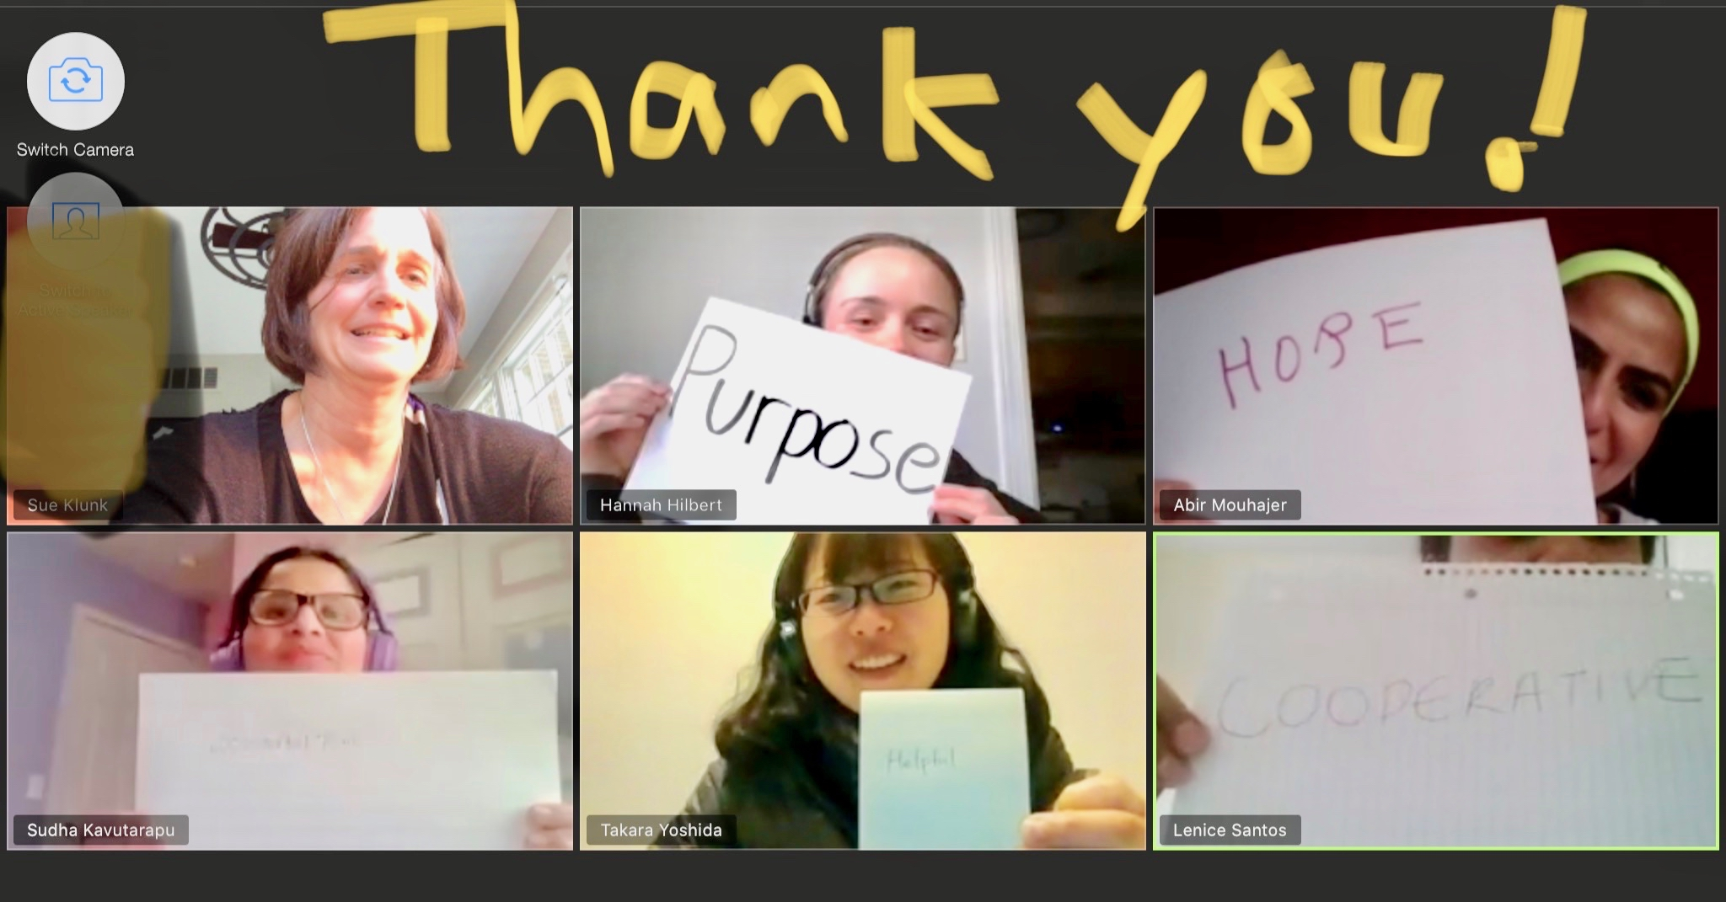

Slide 2
Excellent
Helpful
Cooperative

